Slide 1
Compilers

Slide 2
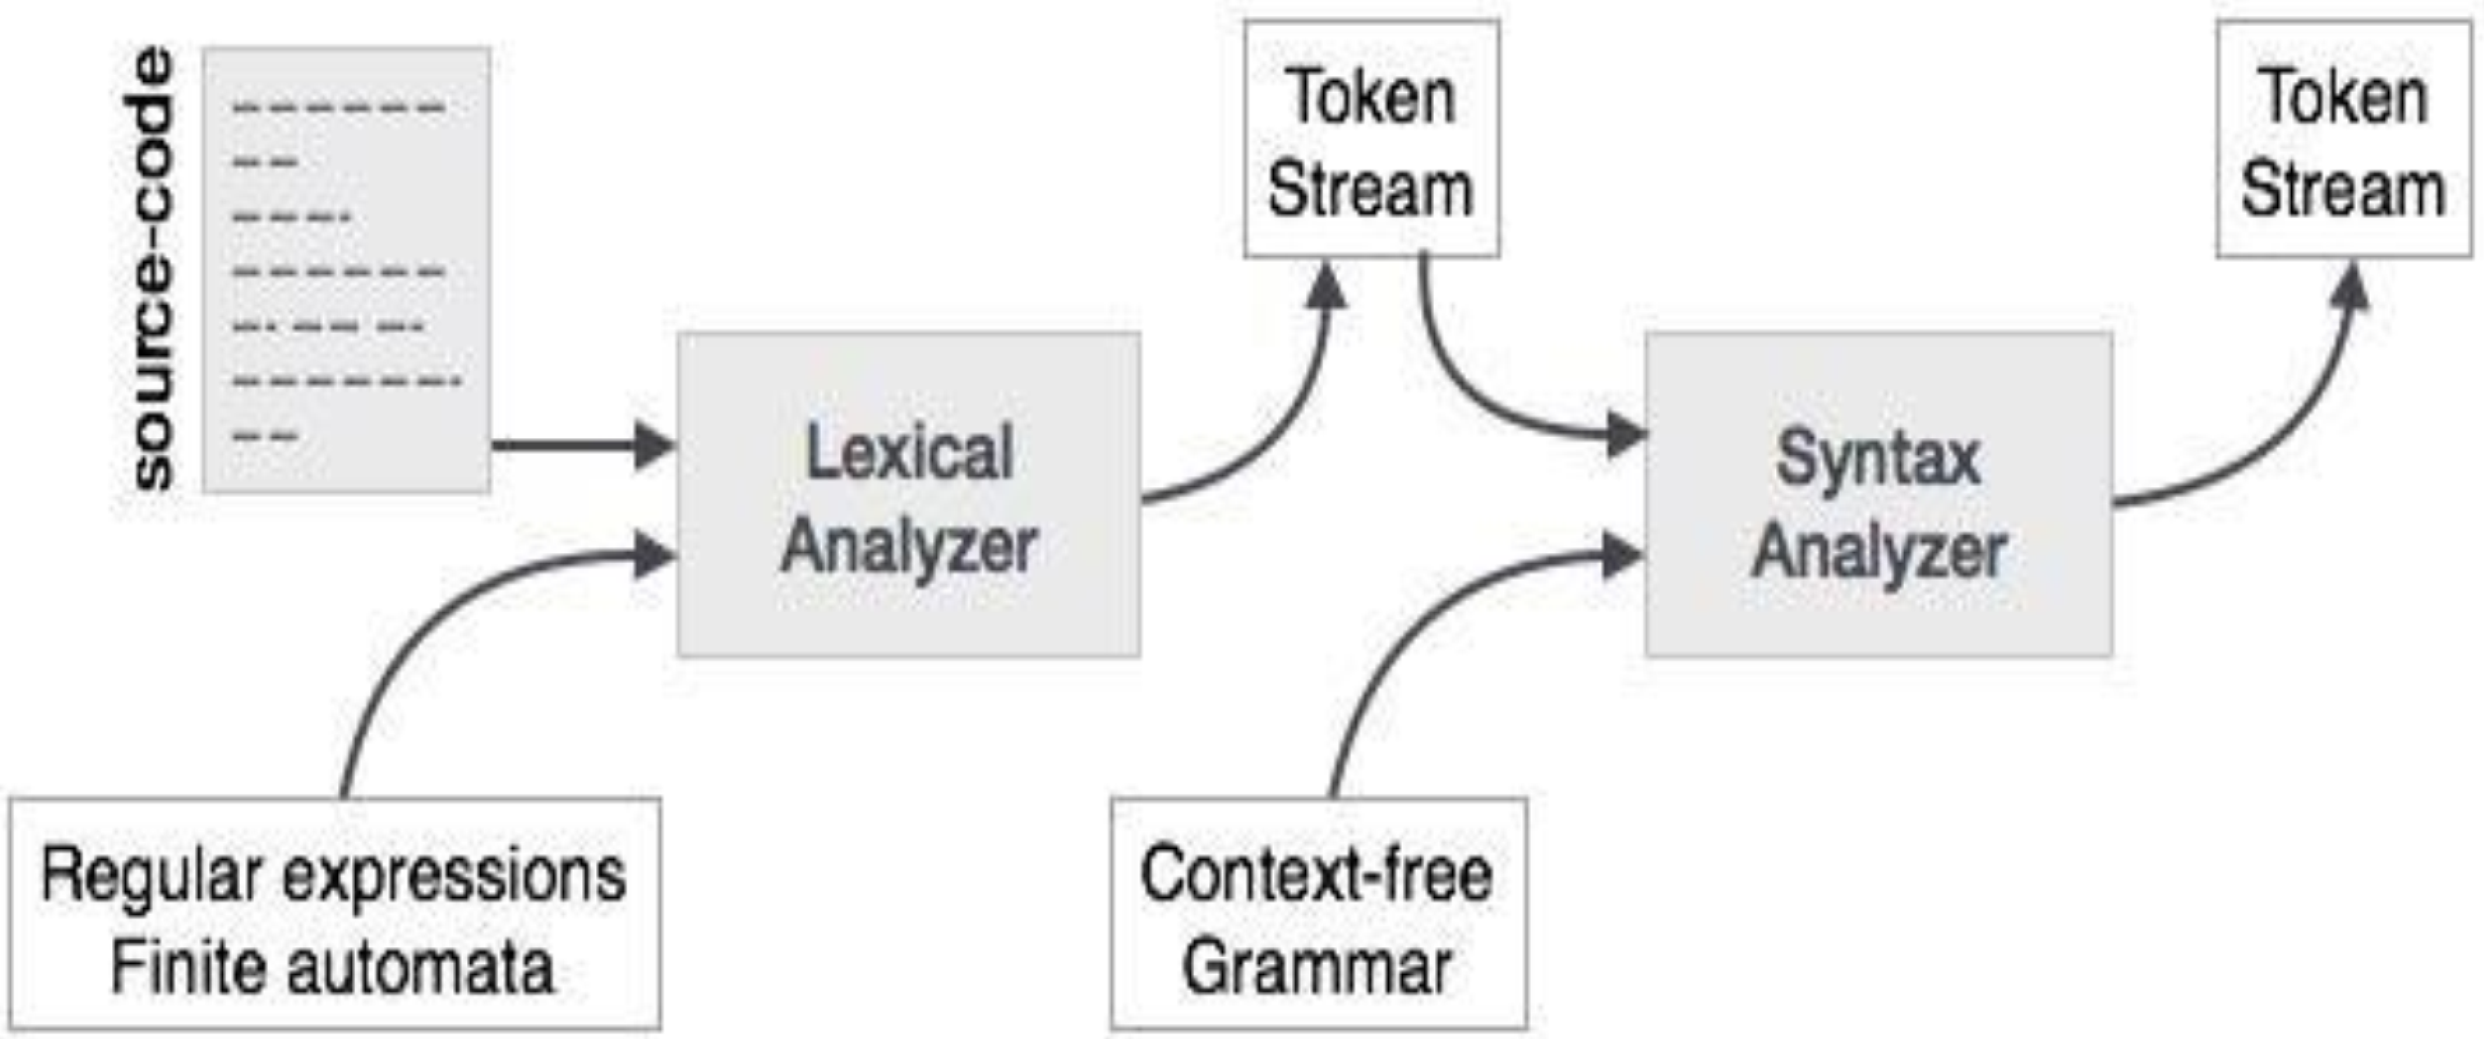
Parser
What is the role of parser?
Parser obtains a string of tokens from the lexical analyser and verifies that the string of token names can be generated by the source language.

Slide 3
Context Free Grammar
Recursive regular expressions
Regex for balanced braces is difficult
{}
{{}}
{{{}}}
…
How can we represent the above forms?
{*}*
What is wrong with the above approach?

Slide 4
Context Free Grammar
Solution
S=> {S}|e
Regular languages are good for
Sequence
Union
Repetition
While Context Free languages are good for
Sequence
Union
recursion

Slide 5
Context Free Grammar
Have four components
Terminals: basic symbols from which strings are formed.
Tokens coming from the lexer.
Non-terminals: syntactic variables that denote sets of strings
Statement and expressions
Productions: Phrase structure rules specifying the manner in which terminals and non-terminals can be combined to form strings.
Defines the rule of the language.
Start symbol: Top-level phrase from where the production begins
Determines which non-terminal represents the language as a whole

Slide 6
Grammar
Terminal
E -> T + E
E -> T
T-> F x t
T-> F
F -> (E)
F -> n
Non-Terminal
Production

Slide 7
Example
E → E + E
E → E * E
E → id

Slide 8
How to parse
During parsing, we take two decisions for an input
Decide the non-terminal which is to be replaced
Decide the production rule, by which the non-terminal will be replaced
To decide which non-terminal to be replaced with production rule, we can have two options.
Left-most derivation
Right-most derivation

Slide 9
Derivation
A derivation is basically a sequence of production rules, in order to get the input string.
Left-most
Input is scanned and replaced from left to right
Right-most
If we scan and replace the input with production rules, from right to left.

Slide 10
Example
Grammar
E → E+E
E → E*E
E →id
Input string
Id + id * id
Left-Most
E → E * E E → E + E * E E → id + E * E E → id + id * E E → id + id * id
Right-most
E → E + E E → E + E * E E → E + E * id E → E + id * id E → id + id * id

Slide 11
Parse Tree
Parse tree is a graphical depiction of a derivation
Is convenient to see how strings are derived from the start symbol
Start symbol of the derivation becomes the root of the parse tree.
Contains terminals at the leaves
Contains non-terminals at the interior nodes.
An in-order traversal of the leaves is the original input.
Parse tree shows the association of operations, the input string does not.

Slide 12
Ambiguity Introduction
A grammar is ambiguous if it has more than one parse tree for some string.
Ambiguity is bad because
it leaves meaning of some programs not well defined.
It might result in an unintended result

Slide 13
Ambiguity
A grammar that produces more than one parse tree for some sentence is said to be ambiguous
An ambiguous grammar is one that produces more than one leftmost derivation or more than one rightmost derivation for the same sentence.
How to determine “if” and “if2” as a keyword and an identifier.
Solution treat all keywords as identifier and then check if identifier is keyword.

Slide 14
Example
Grammar
E= E+E / E*E / id
For the statement a+b+c
For the statement a+b*c

Slide 15
Solution
Will look into more detail later
For first example
E = E + id / id
For second Example
E = E+T / T
T= T*F / F
F = id
For Associativity -> Recursion
For precedence -> Level

Slide 16
Example
Write a grammar that is unambiguous for an expression which might contain +, *, and ^.

Slide 17
Solution
E= E+T / T
T=T*F / F
F = G^F / G
G = id

Slide 18
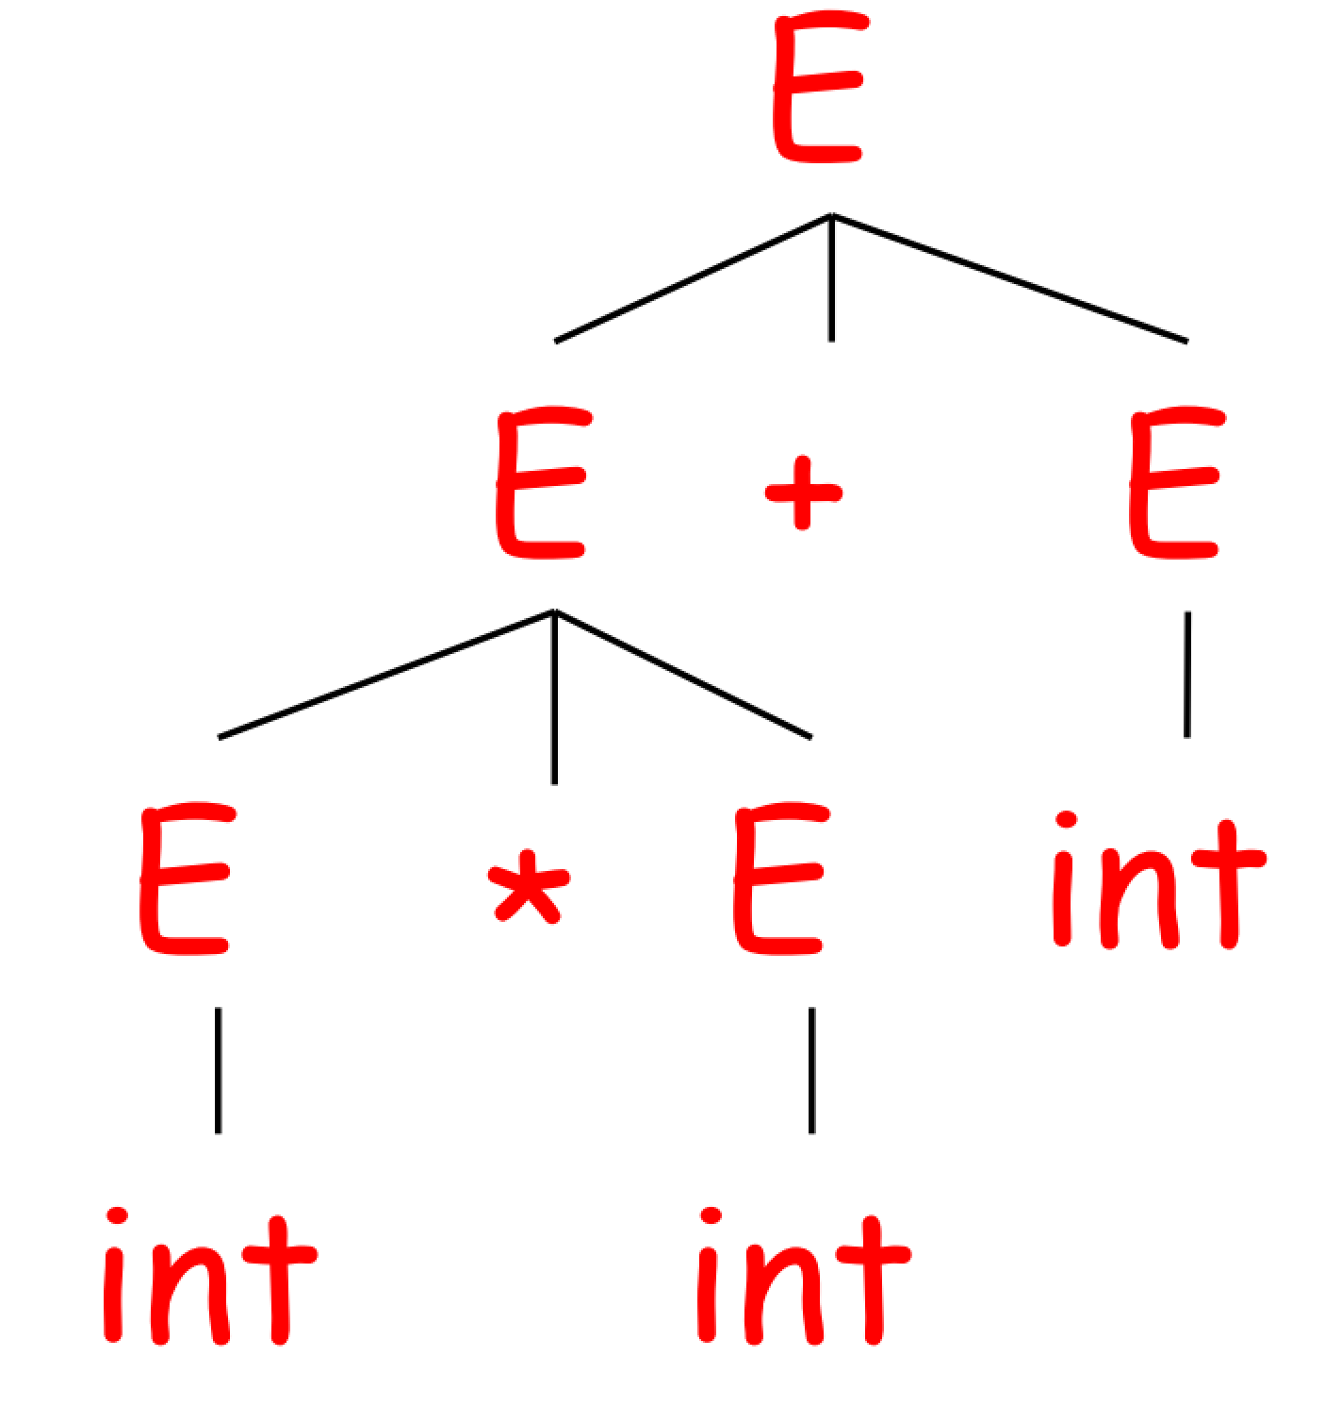
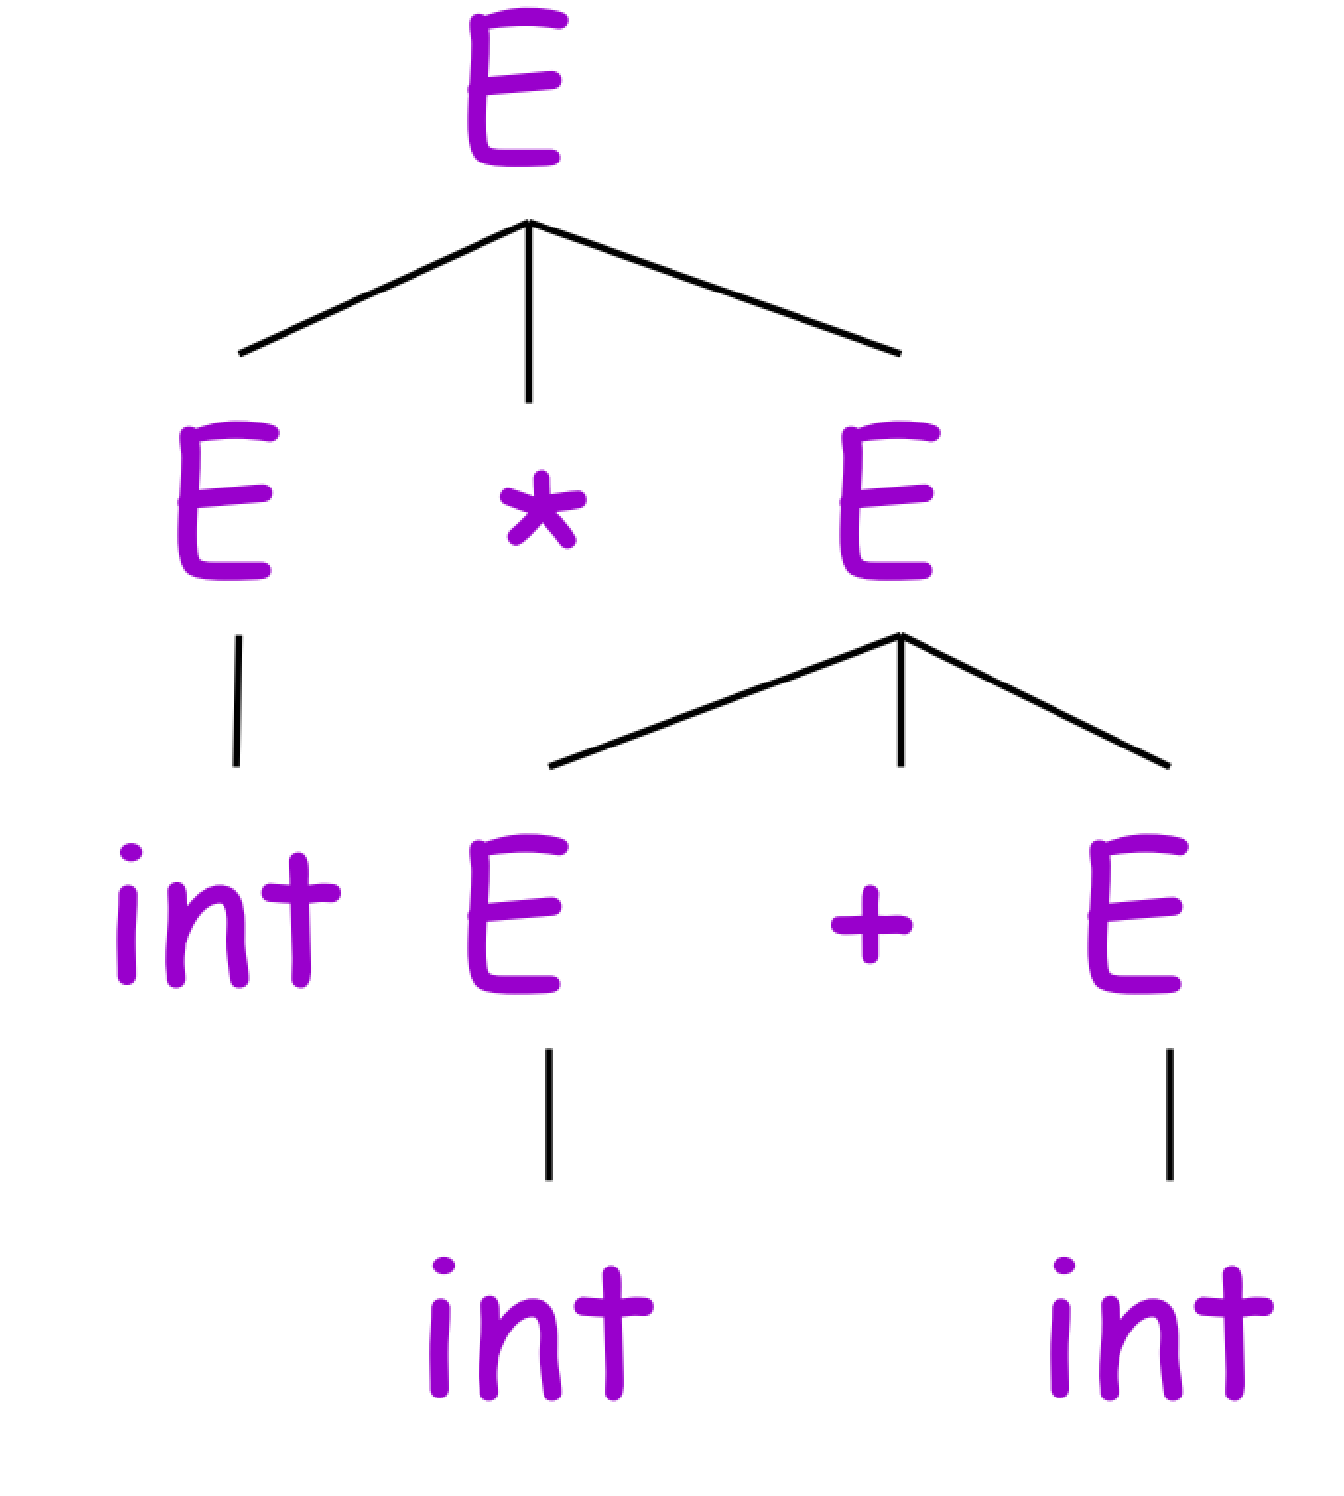
Example
Grammar
E → E + E | E * E | ( E ) | int
Input string
Int * int + int

Slide 19
Example
Grammar
bExp → bExp or bExp | bExp and bExp | not bExp | true | false
Is this an ambiguous grammar?

Slide 20
Solution
Redifine the grammer
bExp → bExp or F | F
F → F and G | G
G → Not G | True | False

Slide 21
Example
Is the following grammar ambiguous? if yes, find another grammar that is unambiguous
E → E + E | E * E | E ^ E | id

Slide 22
Solution
E → E + T | T
T → T * F | F
F → F ^ G | G
G → id

Slide 23
Left recursion
A grammar becomes left-recursive if it has any non-terminal ‘A’ whose derivation contains ‘A’ itself as the left-most symbol
A=> Aα | β
Disadvantage of left recursion is that it will create an infinite loop in a top down parser.
Solution
A => βA’
A’ => αA’ | ε

Slide 24
Left Factoring
If more than one grammar production rules has a common prefix string, then the parser cannot make a choice as to which of the production it should take to parse the string
A ⟹ αβ | α𝜸 | …
Solution
A => αA’
A’=> β | 𝜸 | …

Slide 25
First set
An important part of parser table construction.
Helps to know what terminal symbol is derived in the first position by a non-terminal.

Slide 26
Follow set
What terminal symbol immediately follows a non-terminal in production rules
Rules
If S is a start symbol, then FOLLOW(S) = $
If a is a non-terminal and has a production α → AB, then FIRST(B) is in FOLLOW(A) except ℇ.
if α is a non-terminal and has a production α → AB, where B → ℇ, then FOLLOW(A) is in FOLLOW(α).

Slide 27
Example
Find the first set and follow set of the following grammars
S=> ACB/CbB/Ba
A=>da/BC
B=> g/e(epsilon)
C=>h/e(epsilon)
Remove the left factoring of the following expression
S=> aSSbs/aSaSb/abb/b

Slide 28
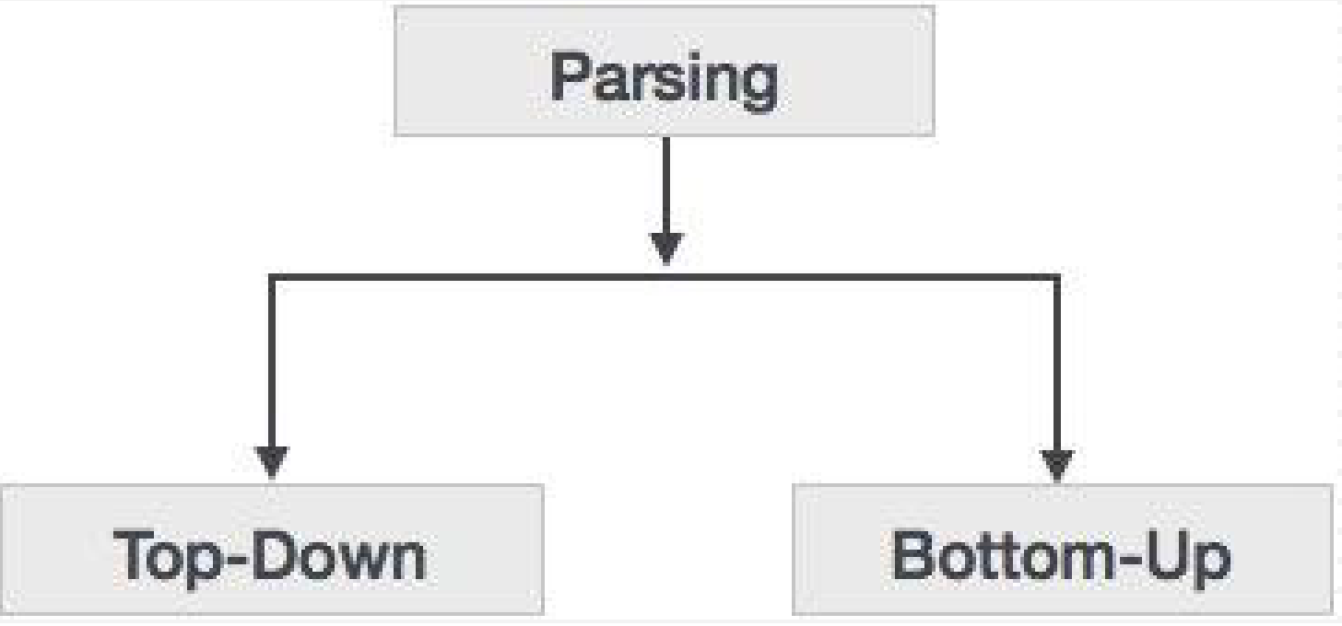
Types of Parsing
The way the production rules are implemented (derivation) divides parsing into two types: top-down parsing and bottom-up parsing.

Slide 29
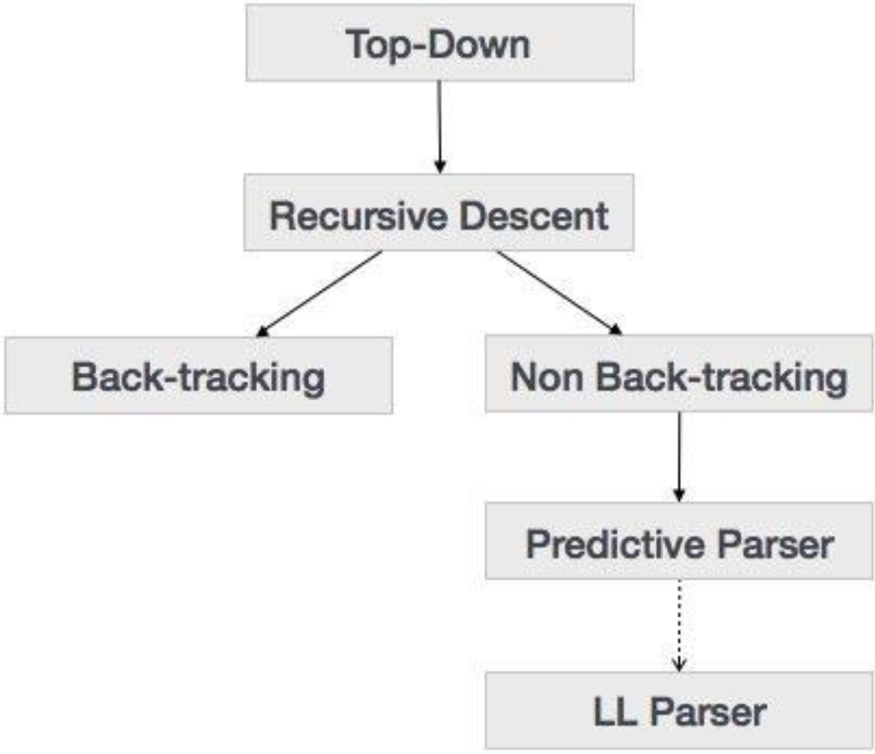
Types of Top-down parsing
The parse tree is constructed
From the top
From left to right
Terminals are seen in order of
Of appearance in the token
stream

Slide 30
Recursive descent parsing
It is called recursive, as it uses recursive procedures to process the input.
Recursive descent parsing suffers from backtracking.
If one derivation of a production fails, the syntax analyser restarts the process using different rules of same production

Slide 31
Example
Consider the grammar
E-> T| T + E
T -> int | int * T | (E)
Token stream is: ( int )
Start with top-level non-terminal E (start symbol
Try the rules for E in order

Slide 32
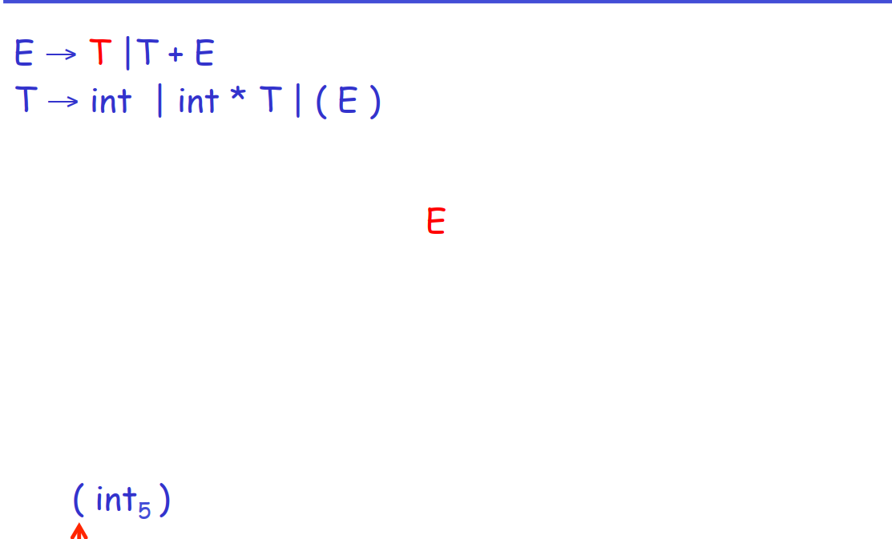
Recursive descent parsing

Slide 33
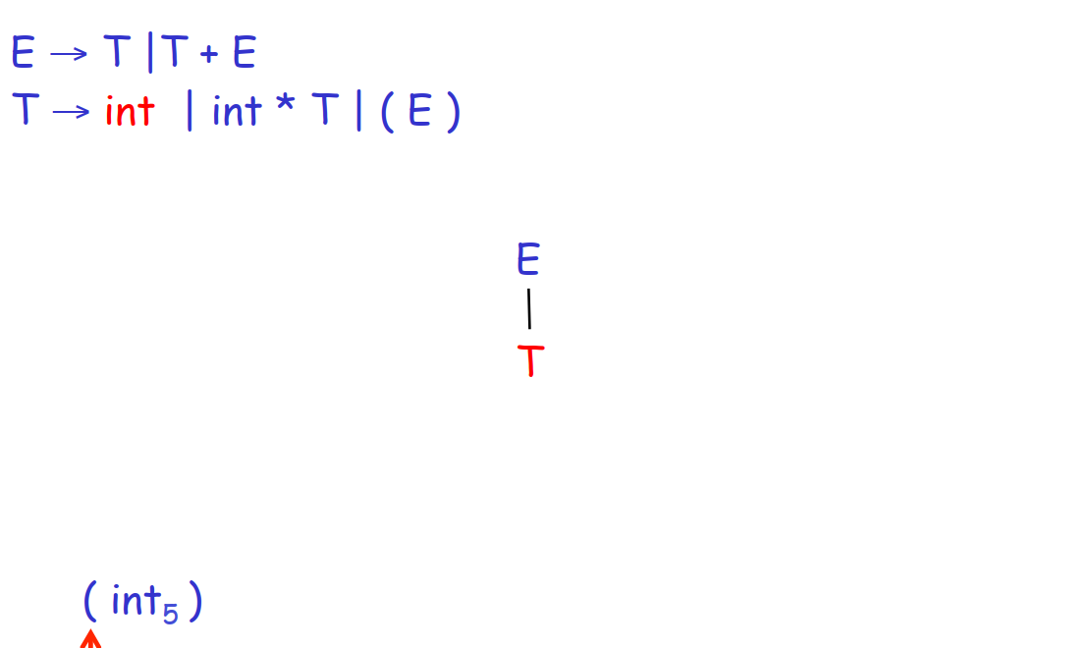
Recursive descent parsing

Slide 34
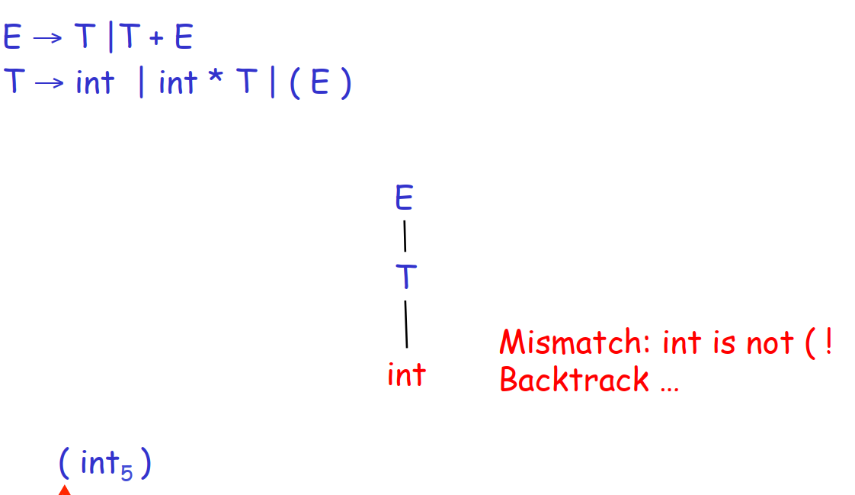
Recursive descent parsing

Slide 35
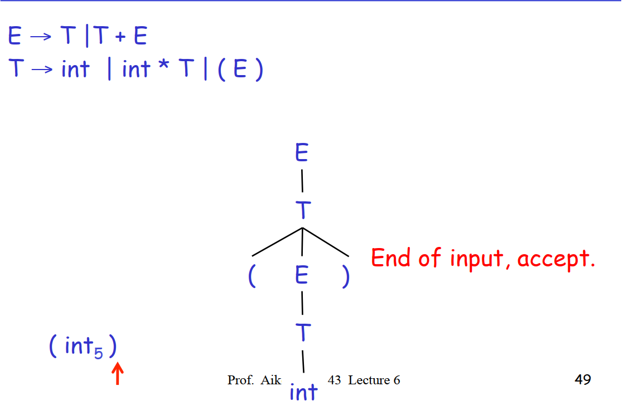
Recursive descent parsing

Slide 36
Implementation of recursive decent parsing
Let TOKEN be the type of tokens
Special tokens INT, OPEN, CLOSE, PLUS, TIMES
Let the global next point to the next token.
Define Boolean functions that check the token string for a match of

Slide 37
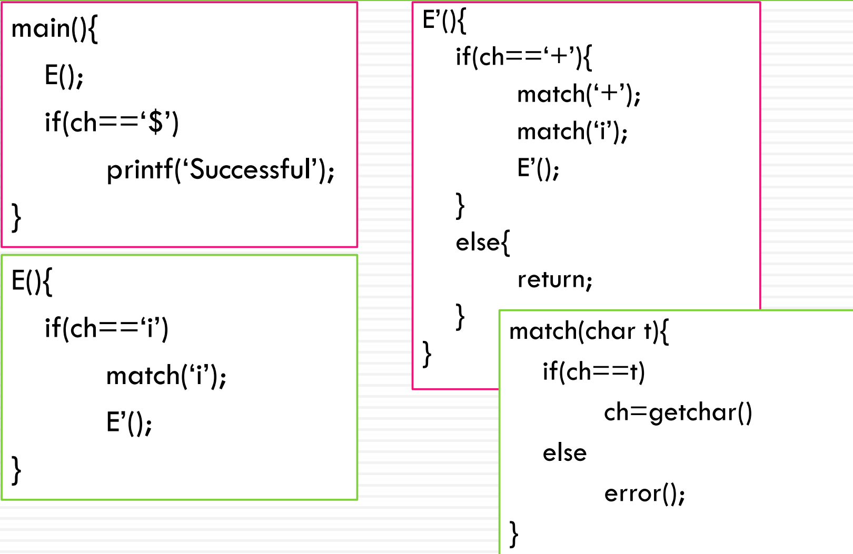
Example
E -> iE’
E’ -> +iE’ | e

Slide 38
Predictive parsers
Like recursive-descent but parser can “predict” which production to use
By looking at the next few tokens
No backtracking
Predictive parsers accept LL(K) grammars
L means ”Left-to-right” scan of input
L means “leftmost derivation”
K means “predict based on k tokens of lookahead”
In practice LL(1) is used

Slide 39
LL(1)
In recursive-descent,
At each step, many choices of production to use
Backtracking used to undo bad choices
In lL(1)
At each step only one choice of production
LL(1) is a recursive descent variant without backtracking
In LL(1) parser we have a stack that is initiated with $, an LL(1) parsing table and an input buffer with a $ appended at the end.

Slide 40
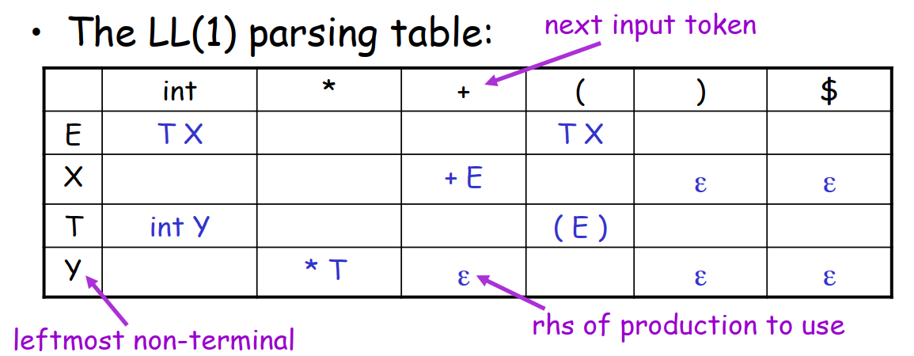
LL(1) parsing table
E-> TX T-> (E)|int Y X-> + E | e Y->*T|e

Slide 41
example
Construct the LL(1) parsing table for the following grammar
E-> TE’
E’-> +TE’ |e
T -> F T’
T’ -> FT’ | e
F -> id | (E)

Slide 42
LL(1) parsing tables errors
Blank entries indicate error situations
If more than one productions are entered in one cell it is an errror,
If it is ambiguous
If it is left recursive
If it is not left-factored
And some other cases as well.

Slide 43
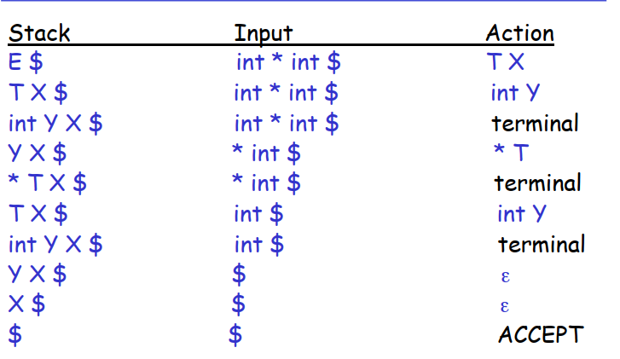
LL(1) parsing example
Parse the input (int * int) using the grammar
E-> TX T-> (E)|int y X-> + E | e Y->*T|e

Slide 44
example
Using the grammar S=> (S) | e
Construct an LL(1) parsing table and check if the input (()) is acceptable

Slide 45
Error Handling
The purpose of a compiler is
To detect non-valid programs
To translate the valid ones
Many kinds of errors
Lexical
Syntax
Semantic
correctness

Slide 46
Syntax Error handling
Goals of the error handler
Report the presence of errors clearly and accurately
Recover from an error quickly enough to detect subsequent errors
Add minimal overhead to the processing or not slow down compilation of valid code.
The error handler should report
The place in the source program where the error is detected
The type of error (if possible)

Slide 47
Error recovery strategies
There are many strategies in error handling:
Panic mode
Error productions
Automatic local or global correction

Slide 48
Panic mode
Simplest and most popular method
When an error is detected:
Discard tokens until one with a clear role is found
Continue from there
Such tokens are called synchronizing tokens
Typically statement or expression terminators (semi colon)

Slide 49
Error productions
Augment the grammar to capture the most common errors that programmers make
Essentially promotes common errors to alternative syntax
Example
Write 5 x instead of 5 * x
Add the production E -> .. E E
Disadvantage
Complicates the grammar

Slide 50
Local and global correction
Find a correct “nearby” program
Try token insertion and deletion
Exhaustive search
Makes as few changes as possible in the program so that a globally least cost correction program is obtained.
Disadvantage
Hard to implement
Slows down parsing of correct programs
“Nearby” is not necessarily “the intended” program

Slide 51
Error recovery development
In the past
Slow recompilation cycle
Find as many errors in one cycle as possible
many researches were done on this topic
Present
Quick recompilation cycle
Users tend to correct one error/cycle
Complex error recovery is less compelling
Panic-mode seems enough

Slide 52
Bottom up parsing

Slide 53
Bottom-up parsing
Begins parsing at the leaves (the bottom) and works up towards the root (the top)
The key decisions in bottom-up parsing are
When to reduce
What production to apply, as the parse proceeds
At each reduction step a particular substring matching the right side of a production (body) is replaced by the symbol of the left of that production
If the substring is chosen correctly at each step, a rightmost derivation is traced out in reverse.

Slide 54
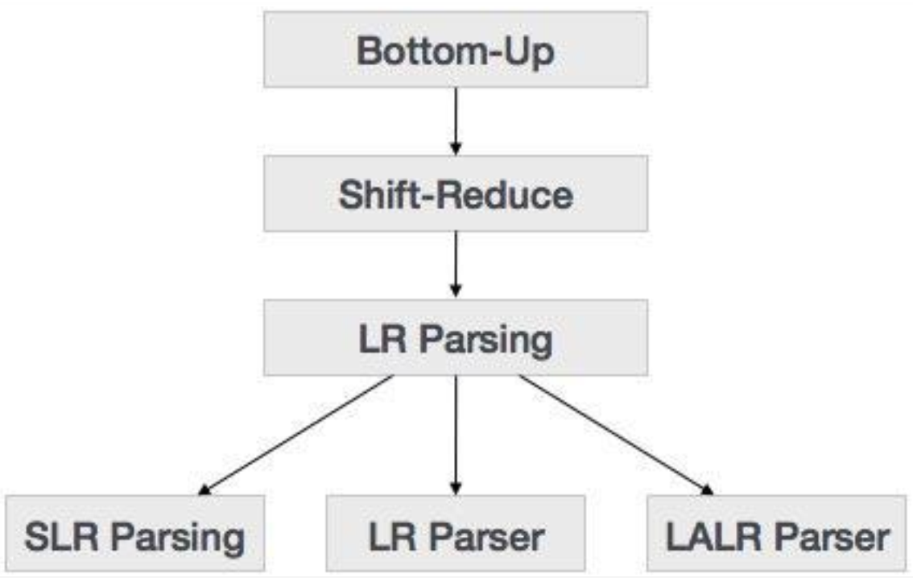

Slide 55
Operator precedence parsing
Operator grammer
E-> E + E / E * E / id (is an operator grammer)
E-> EAE / id
A-> + / * (is not operator grammar)
In operator grammar no two variables should come side by side.

Slide 56
Example
E-> E + E / E * E / id
Id+id*id$
g
 | Id | + | * | $
Id | - | > | > | >
+ | < | > | < | >
* | < | > | > | >
$ | < | < | < | -
f
 | Id | + | * | $
F | 4 | 2 | 4 | 0
G | 5 | 1 | 3 | 0

Slide 57
Handle pruning
A “Handle” is a substring that matches the body of a production, and whose reduction represents one step along the reverse of a rightmost derivation
Removing the children of left hand side non terminal from the parser tree is called handle pruning.
Right sentential form | Handle | Reducing production
Id1 * id2 | Id1 | F-> id
F * id2 | F | T->F
T * id2 | Id2 | F->id
T * F | T * F | T -> T * F
T | T | E-> T
E

Slide 58
Shift reduce parsing
Use two unique steps for bottom-up parsing
Shift step:
The shift step refers to the advancement of the input pointer to the next input symbol (the shifted symbol)
This symbol is pushed onto the stack. The shifted symbol is treated as a single node of the parse tree.
Reduce step:
When the parser finds a complete grammar rule (RHS) and replaces it to (LHS), it is known as reduce-step. This occurs when the top of the stack contains a handle.
To reduce, a POP function is performed on the stack which pops off the handle and replaces it with LHS non-terminal symbol.

Slide 59
Cont.
A stack holds grammar symbols
An input buffer holds the rest of the string to be parsed
The handle always appears at the top of the stack just before it is identified as the handle
$ is used to mark the bottom of the stack and also the right end of the input
Conflicts might arise during shift-reduce parsing
Deciding whether to shift or to reduce (shift/reduce conflict), or
Deciding which of several reductions to make (a reduce/reduce conflict)

Slide 60
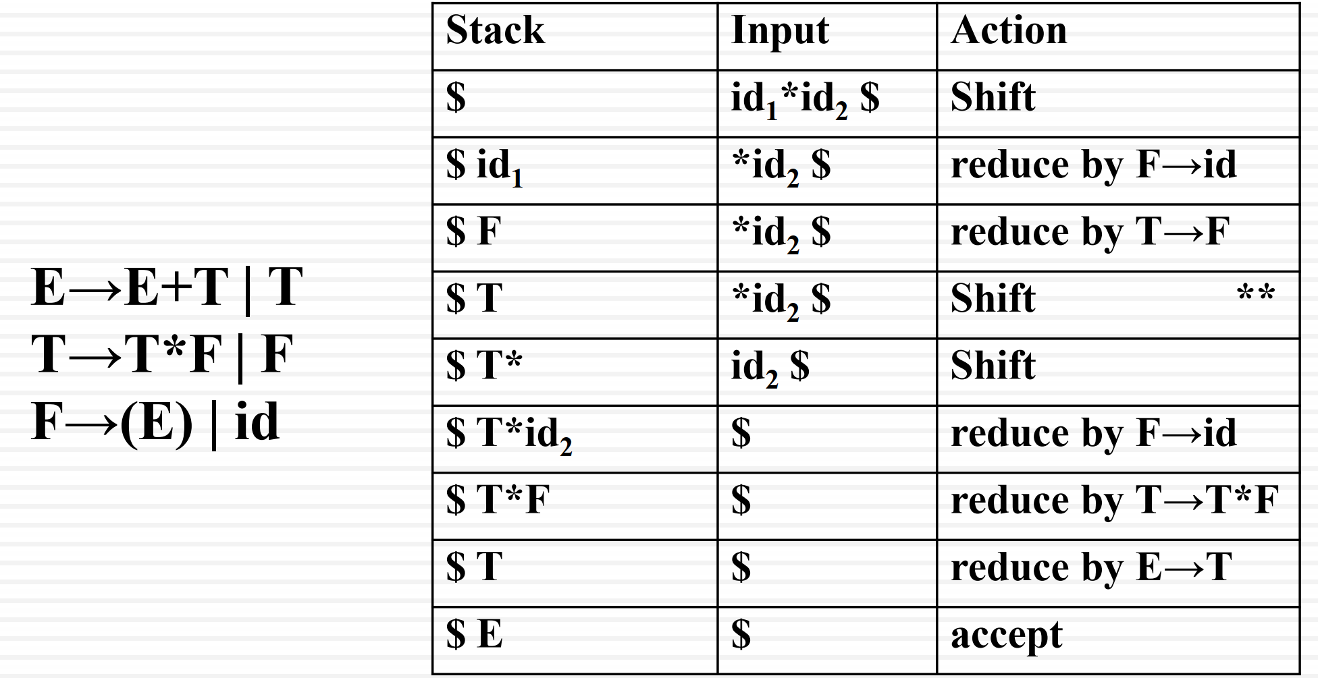
Example

Slide 61
LR parser
LR(K) parser is a non-recursive, shift reduce, bottom-up parser
“L” stands for left-to right scanning of the input
“R” stands for a rightmost derivation in reverse, and
“K” is for the number of input symbols of lookahead that are used in making parsing decisions
When (k) is omitted it is assumed to be 1
It uses a wide class of context-free grammar which makes it the most efficient syntax analysis technique.

Slide 62
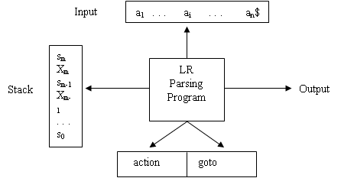
Components of LR parser
Stack
Input buffer
LR parsing algorithm
Parsing table
Has two parts
Action and goto.

Slide 63
LR parsing algorithm
The parser reads characters from an input buffer one at a time
The program uses a stack to store a string of the form s₀X1S₁X₂…X_{m}S_{m}, where Sm is on top.
Each Xi is a grammar symbol and each Si is a symbol called a state
The parsing program behaves as follows.
It determines Sm, the state currently on top of the stack, and ai, the current input symbol
Consults action [Sm,ai], the parsing action table entry for state Sm and input ai, which can have one of four values:
Shift s, reduce by a grammar production A-> B, accept, and error

Slide 64
LR parsing algorithm
The four types of actions are as follows:
If action [Sm, ai] = shift s, then parser shifts
the current input symbol ai and
the next state s, which is given in action[sm, ai], onto the stack
ai+1 become the current input symbol
If action[sm, ai] = reduce A→β, then the parser executes a reduce move,
Here the parser
first pops 2r symbols off the stack (r state symbols and r grammar symbols),
Then pushes both A, the left side of the production, and s, the entry for goto[sm-r, A], onto the stack
The current input symbol is not changed
If action[sm, ai] = accept, parsing is completed
If action[sm, ai] = error, the parser has discovered an error and call an error recovery routine

Slide 65
LR parsing table
Si means shift and stack state i
Rj means reduce by a production numbered j
acc means accept
Blank means error.
Example
1) E-> E + T
2) E -> T
3) T -> T * F
4) T -> F
5) F -> ( E )
6) F -> id

Slide 66
Parsing table
State | Action |  |  |  |  |  | Goto
 | Id | + | * | ( | ) | $ | E | T | F
0 | s5 |  |  | s4 |  |  | 1 | 2 | 3
1 |  | s6 |  |  |  | acc
2 |  | r2 | s7 |  | r2 | r2
3 |  | r4 | r4 |  | r4 | r4
4 | s5 |  |  | s4 |  |  | 8 | 2 | 3
5 |  | r6 | r6 |  | r6 | r6
6 | s5 |  |  | s4 |  |  |  | 9 | 3
7 | s5 |  |  | s4 |  |  |  |  | 10
8 |  | s6 |  |  | s11
9 |  | r1 | s7 |  | r1 | r1
10 |  | r3 | r3 |  | r3 | r3
11 |  | r5 | r5 |  | r5 | r5

Slide 67
Parsing example
On input id*id+id, the sequence of stack and input content is as follows
Stack |  | Input | Action
(1) | 0 | id*id+id $ | Shift
(2) | 0 id 5 | *id+id $ | reduce by F→id
(3) | 0 F 3 | *id+id $ | reduce by T→F
(4) | 0 T 2 | *id+id $ | Shift
(5) | 0 T 2*7 | id+id $ | Shift
(6) | 0 T 2*7 id 5 | +id $ | reduce by F→id
(7) | 0 T 2*7 F 10 | +id $ | reduce by T→T*F
(8) | 0 T 2 | +id $ | reduce by E→T
(9) | 0 E 1 | +id $ | Shift
(10) | 0 E 1+6 | id $ | Shift
(11) | 0 E 1+6 id 5 | $ | reduce by F→id
(12) | 0 E 1+6 F 3 | $ | reduce by T→F
(13) | 0 E 1+6 id 9 | $ | reduce by E→E+T
(14) | 0 E 1 | $ | Accept

Slide 68
Exercise
Will the input string “aabb$” be accepted by the grammar?
1) S-> AA 2)A->aA 3) A->b
State | Action |  |  | Goto
 | a | b | $ | A | S
0 | S3 | S4 |  | 2 | 1
1 |  |  | Acc
2 | S3 | S4 | R2 | 5
3 | S3 | S4 |  | 6
4 | R3 | R3 | R3
5 | R1 | R1 | R1
6 | R2 | R2 | R2

Slide 69
Types of LR Parsers
LR(0)
SLR(1) –Simple LR
LALR(1) – Look ahead LR
CLR(1) – canonical LR

Slide 70
LR parser types
There are 3 widely used algorithms available for constructing an LR parser
SLR(1) simple LR parser:
Works on smallest class of grammar
Few number of states, hence very small table
Simple and fast construction
LR(1) – LR Parser:
Works on complete set of LR(1) Grammar
Generates large table and large number of states
Slow construction
LALR(1) – Look-Ahead LR Parser:
Works on intermediate size of grammar
Number of states are same as in SLR(1)

Slide 71
LR (0) parsing table construction
Construction of LR(0) parsing table relies on identifying the following terms.
LR(0) Item/Item
Item sets/Canonical LR(0)
LR(0) State
Augmented Grammar
Closure Operation
Goto Operation

Slide 72
Item
An LR(0) item (item for short)
is a production of a grammar G with a dot at some position of the right side
For example
the rule E → E + B has the following four corresponding items:
E → • E + B
E → E • + B
E → E + • B
E → E + B •
Rules of the form A → ε have only a single item A → .
An item indicates what is the part of a production that we have seen and what we hope to see.

Slide 73
Item set
An LR(0) state is a set of Items
To construct the canonical LR(0) collection for a grammar,
we define an augmented grammar and
two functions: closure and goto

Slide 74
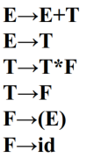
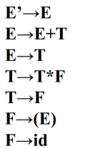
Augmented grammar
If G is a grammar with start symbol S, then G‟, the augmented grammar for G, is G with a new start symbol S‟ and production S‟→S
The purpose of this new starting production is to indicate the parser when it should stop parsing and announce the acceptance of the input, i.e., acceptance occurs when and only when the parser is about to reduce S’→S

Slide 75
The closure operatoion
The closure of an item set written as closure(I) where I is an item set
If I is a set of items of G, then closure(I) is the set of items constructed by two rules:
Initially, every item in I is added to closure(I)
If A→α.Bβ is in closure(I) and B→γ is a production, then add B→.γ to I.
It is these closed item sets that are taken as the states of the parser
If I is the set of one item: {[E‟→.E]}, then closure(I) contains the items: E‟→.E E→.E+T E→.T T→.T*F T→.F F→.(E) F→.id

Slide 76
The goto operation
The second useful function is goto(I, X) where I is a set of items and X is a grammar symbol
goto(I, X) is defined as the closure of all items [A→αX.β] such that [A→α.Xβ] is in I
If I is the set of two items {[E‟→E.], [E→E.+T]}, then goto(I, +) consists of
E→E+.T T→.T*F T→.F F→.(E) F→.id

Slide 77
LR(0) table construction
If state i contains S‟→ S.
Then
table[i,$] = accept
If state i contains rule k: X →Y.
Then
table[i,T] = rk for all terminals T
For goto(Ii, T) = Ij OR Transition from i to j marked with T
Then
table[i,T] = sj
For goto(Ii, X) = Ij OR Transition from i to j marked with X
Then
table[i,X] = j

Slide 78
Example
Construct the LR(0) Canonical Set for the following grammar
S →( L )
S → x
L → S
L → L , S

Slide 79
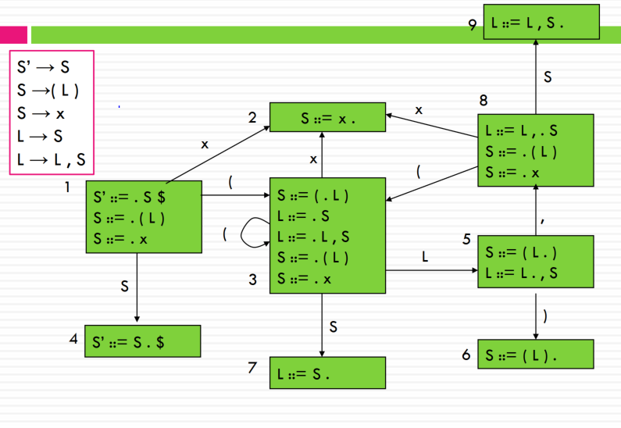
Answer

Slide 80
The LR (0) parsing table
State | ( | ) | X | , | $ | S | L
1 | S3 |  | S2 |  |  | G4
2 | R2 | R2 | R2 | R2 | R2
3 | S3 |  | S2 |  |  | G7 | G5
4 |  |  |  |  | A
5 |  | S6 |  | S8
6 | R1 | R1 | R1 | R1 | R1
7 | R3 | R3 | R3 | R3 | R3
8 | S3 |  | S2 |  |  | G9
9 | R4 | R4 | R4 | R4 | R4

Slide 81
SLR (1) parsing table generation
SLR (k): Simple LR with k tokens of lookahead
For reductions, consider next token
When does this reduction make sense?
Only if it can lead to a correct parse.
Can lead to a correct parse if next token is in FOLLOW SET
Steps are as follows
Generate the collection of item stets as normal for LR(0)
When generating table actions:
Reduce only if next token is in FOLLOW (LHS)
This method is the weakest in terms of number of grammars it succeeds for, but is the simplest to implement.

Slide 82
SLR(1) table construction
If state i contains S‟→ S.
Then
table[i,$] = accept
If state i contains rule k: X →Y.
Then
table[i,T] = rk for all terminals T in follow of X
For goto(Ii, T) = Ij OR Transition from i to j marked with T(terminal)
Then
table[i,T] = sj
For goto(Ii, X) = Ij OR Transition from i to j marked with X(nonterminal)
Then
table[i,X] = j

Slide 83
Example
Construct SLR (1) parsing table for the following grammar
S -> S
X-> a
X -> a b

Slide 84
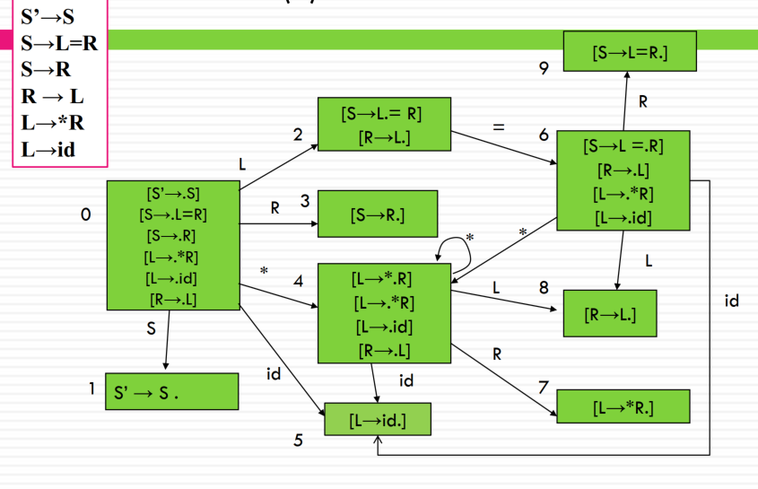
Answer

Slide 85
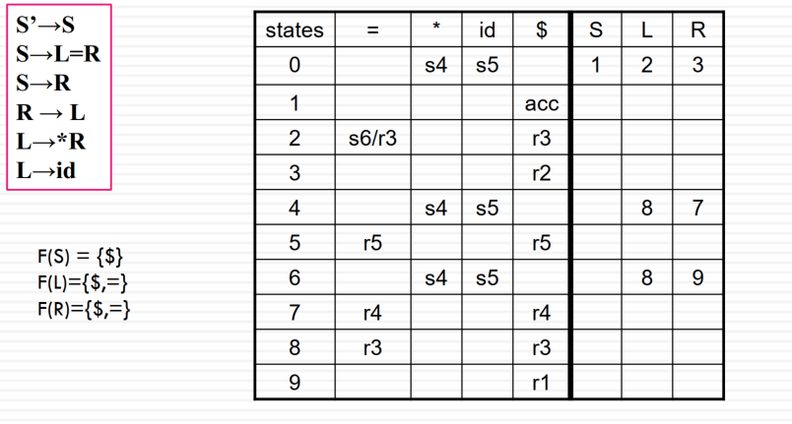
Answer continued
Since there is a shift-reduce conflict, G is not an SLR(1) grammar

Slide 86
LR (1)
Lets examine why the above error occurred
the states produced using LR(0) items do not hold enough information
Solution
Using an LR(1) items that has a form of
[A→α.β, a] where a is a terminal or $

Slide 87
LR(1) items
Items will keep info on
Production
right-hand-side position (the dot)
look ahead symbol LR(1)
Item [A →α• β, T] means
The parser has parsed an α
If it parses a β and the next symbol is T
Then parser should reduce by A →αβ

Slide 88
LR(1) items
LR(1) automata are identical to LR(0) except for the “items” that make up the states
LR(0) items:
X → s1. s2
LR(1) items
X → s1. s2, T look-ahead symbol added

Slide 89
LR(1) closure operation
I is a set of LR(1) items, then closure(I) is found using the following algorithm: Closure(I) repeat for all items [A →α•Xβ, c] in I for any production X → γ for any d ∈First(βc) I = I ∪{ [X →• γ, d] } until I does not change

Slide 90
Closure operation
If I is the set of LR(1) one item: {S‟→.S, $}, then closure(I) contains the items: { [S‟→.S, $] [S→.L=R, $] [S→.R, $] [L→.*R, =] [L→.id, =] [R→.L, $] [L→.*R, $] [L→.id, $] }

Slide 91
Goto operation
The second useful function is goto(I, X) where I is a set of items and X is a grammar symbol Goto(I, X) J = { } for any item [A →α•Xβ, c] in I J = J ∪ closure{[A →αX•β, c]} return J

Slide 92
Go to operation
If I is the set of one item { [L→.*R, =/$]}, then goto(I, *) consists of { [L→*.R, =/$], [L→.*R, =/$], [L→.id, =/$], [R→.L, =/$] }

Slide 93
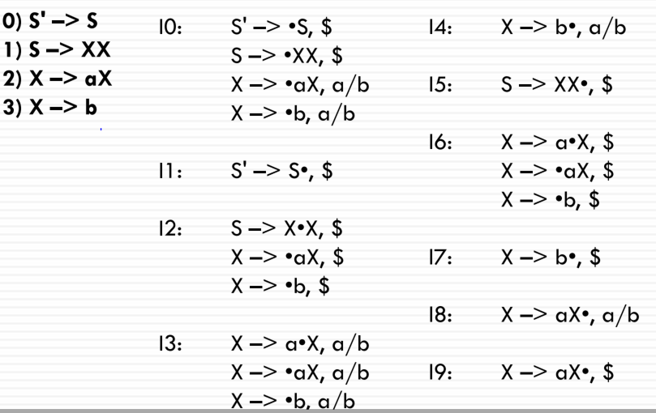
Example
Construct the LR(1) set of items for the following grammar G 0) S' –> S 1) S –> XX 2) X –> aX 3) X –> b

Slide 94
LR(1) table construction
To fill in the entries in the action and goto tables, we use a similar algorithm as we did
for SLR(1), but instead of assigning reduce actions using the follow set, we use the specific lookaheads.
If state i contains S‟→ S.
Then table[i,$] = accept
If state i contains rule k: [X →Y., a]
Then table[i,a] = rk
For goto(Ii, T) = Ij OR Transition from i to j marked with T(terminal)
Then table[i,T] = sj
For goto(Ii, X) = Ij OR Transition from i to j marked with X(nonterminal)
Then table[i,X] = j

Slide 95
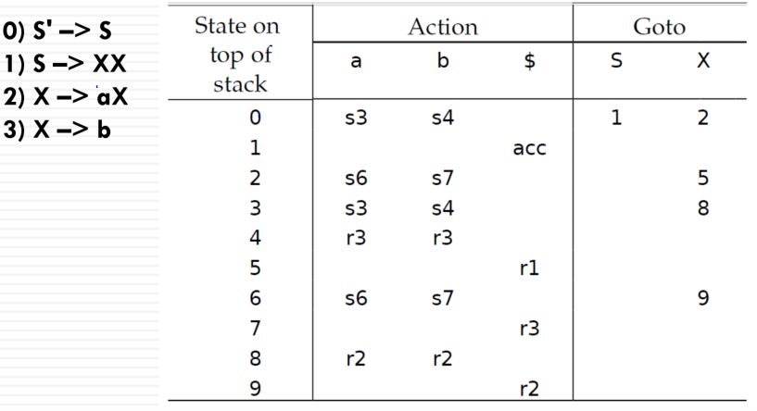
LR(1) parsing table

Slide 96
LALR(1)
Reading assignment

